Slide 1
5 minutes test

Slide 2
Administrative

Slide 3
Grading (slide from course 1)
 |  | Requirements
Assignment 1 | 2 points | 50%
Assignment 2 | 2 points
3 x Speed Tests | 1 point
[BONUS] Good answers / questions during lectures and labs | max 2 points
Project | 5 points | 50%
[BONUS] Good interventions / questions during the poster session | max 1 point
50% rule applies over full scores (does not take into account time penalties)
Maximum 13 points :)

Slide 4
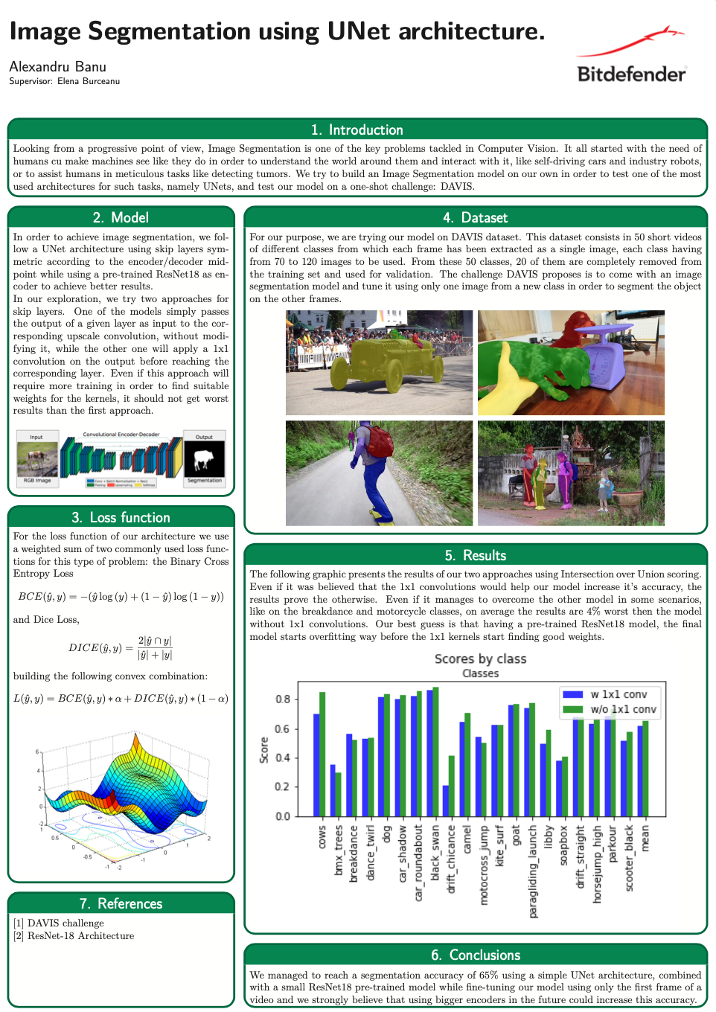
Project - Poster Session
Introduction
Dataset Description
Method (focus on this)
NN Architecture
Algorithm steps
Experiments (focus on this)
Performance
Qualitative Results
Conclusions
Encountered problems
Future work
In-person session
A2, portrait
Ex.: Latex Templates and Posters from DeepFMI 2020

Slide 5
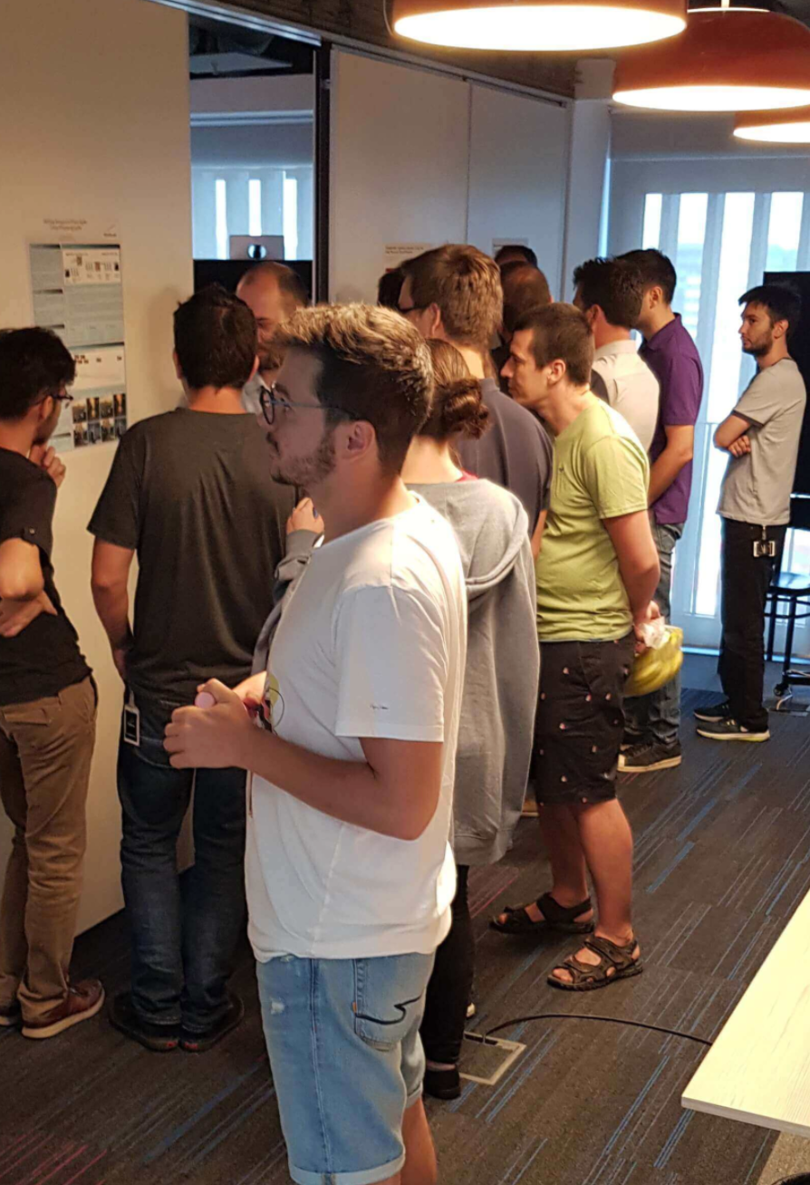
Project - Poster Session
Evaluation based on:
The model is training, the dataset is preprocessed, pytorch and conda worked! (yuhu)
Ablation study (vary the components of the base model)
Answers at the presentation moment (each team member should know all the content of the project)
All team members will have the same grade for the project.
Follow your mentor's instructions!

Slide 6
Deep Learning
9. Unsupervised Learning: Generative Models

Slide 7
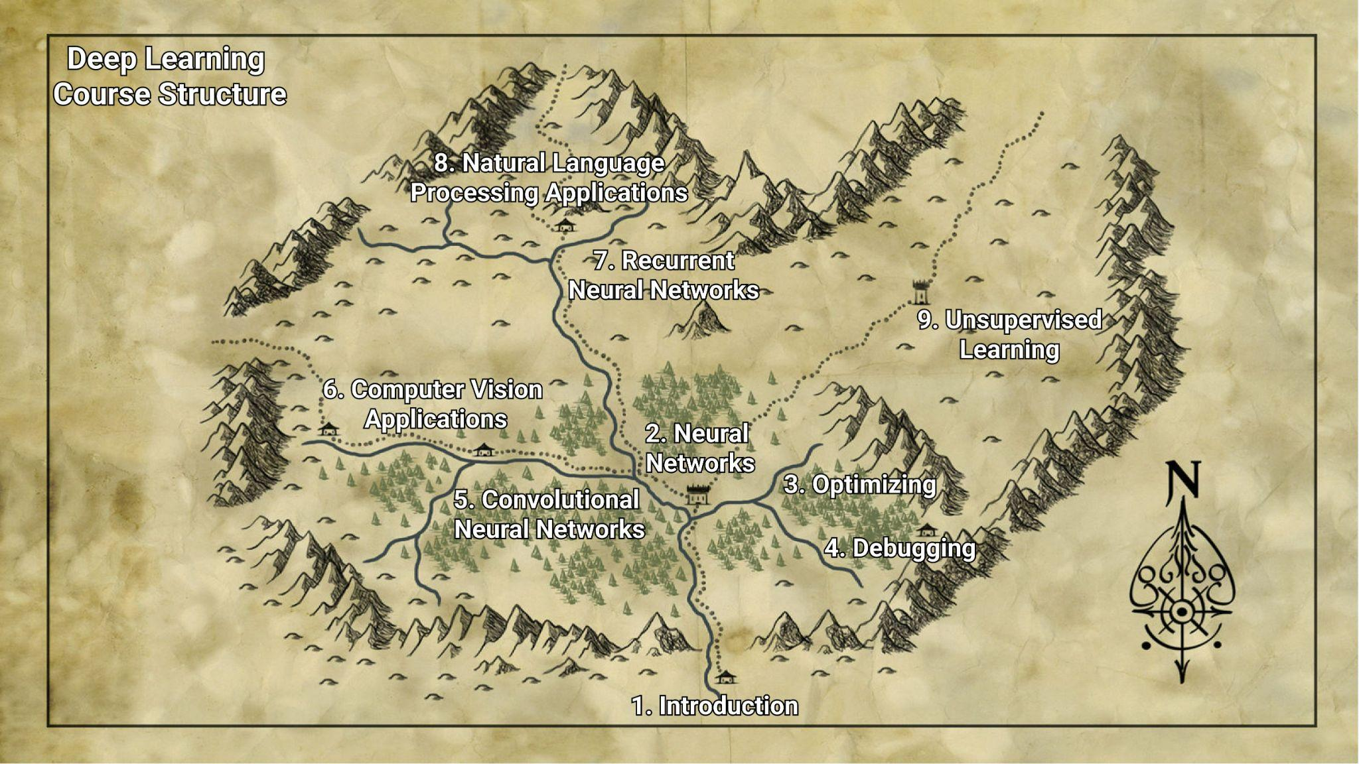



Slide 8
Lecture Overview
Learning Types
Supervised vs. Unsupervised Learning
Discriminative vs. Generative Models
Generative Models
Variational Autoencoder
Generative Adversarial Networks
Diffusion Models

Slide 9
Learning Types
RECAPa
Supervised learning
Unsupervised learning
Reinforcement learning

Slide 10
Learning Types
RECAPa
Supervised learning
Dataset: (x, y) pairs
Goal: Learn the mapping
A function x -> y
Tasks exemple: classification, regression, detection, segmentation, captioning
Unsupervised learning
Dataset: just x, NO LABELS for learning
no supervision signal
self-supervision
Goal: Understand/Find the (hidden) structure of the data
Tasks exemple: clustering, generative models, dimensionality reduction, representation learning
Reinforcement learning

Slide 11
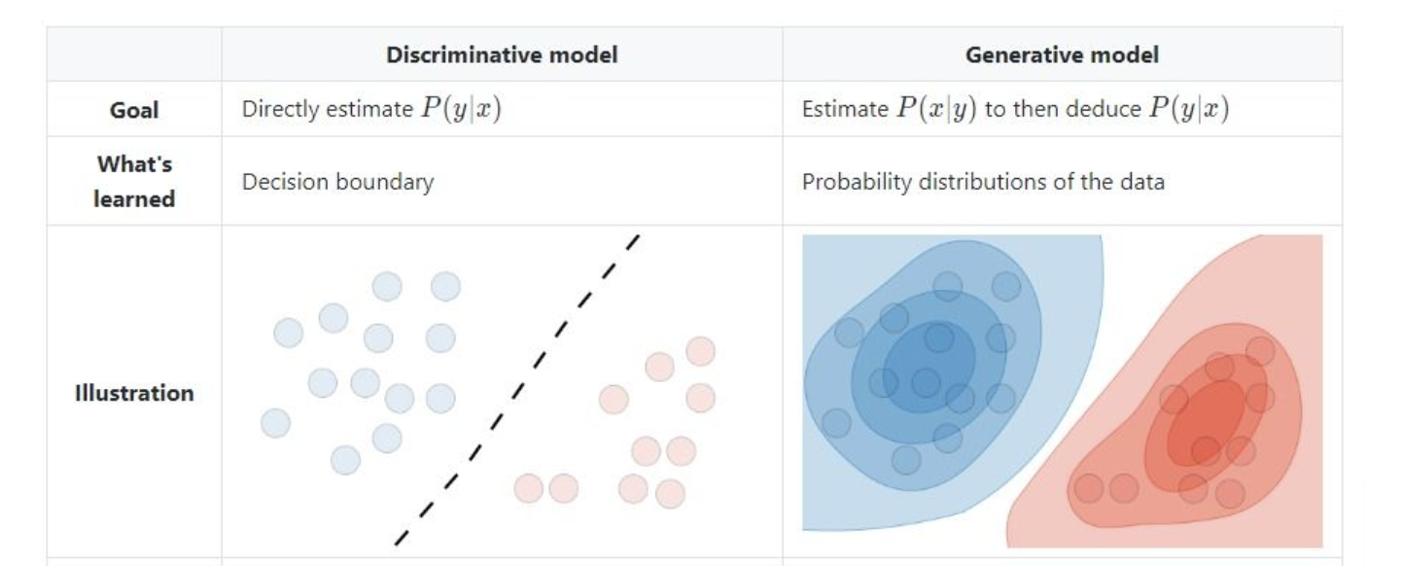
Discriminative vs. Generative
https://www.turing.com/kb/generative-models-vs-discriminative-models-for-deep-learning

Slide 12
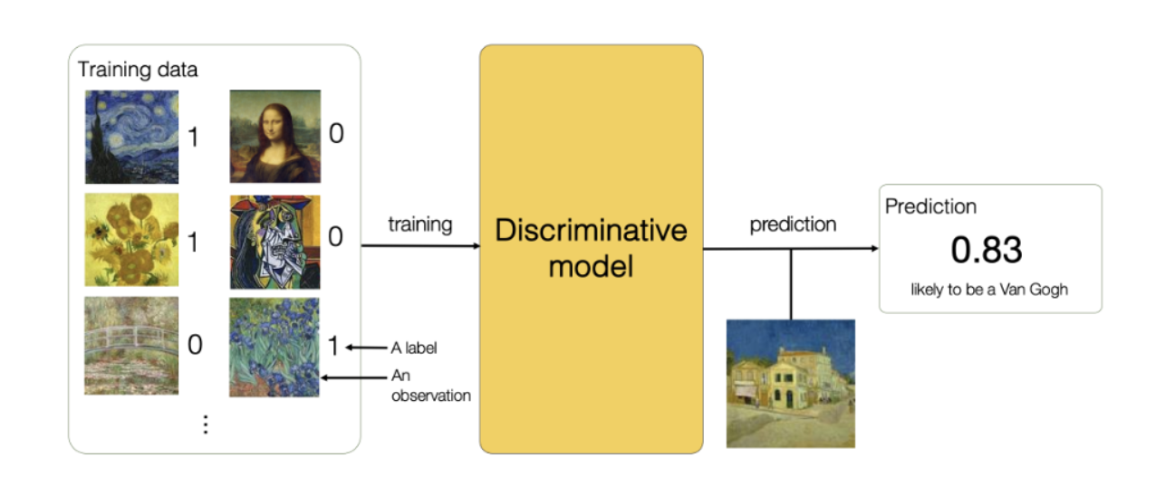
Discriminative Models
https://vitalflux.com/generative-vs-discriminative-models-examples/

Slide 13
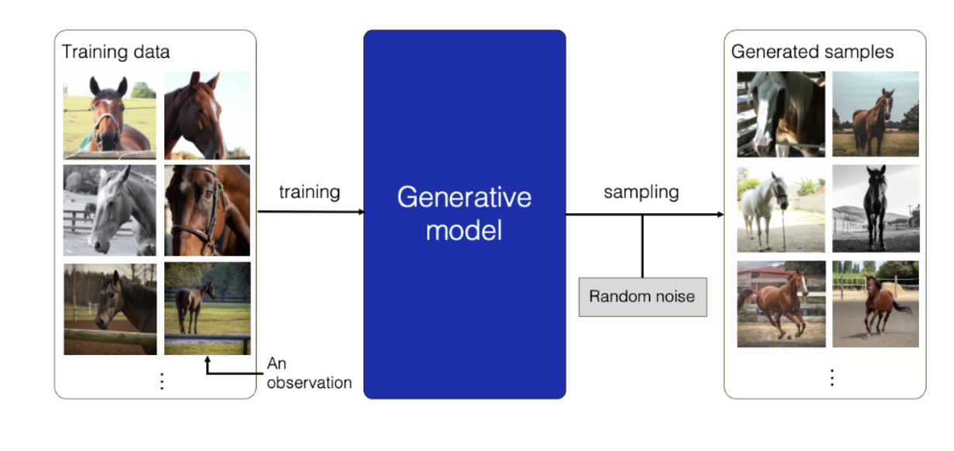
Generative Models
https://vitalflux.com/generative-vs-discriminative-models-examples/

Slide 14
Lecture Overview
Learning Types
Supervised vs. Unsupervised Learning
Discriminative vs. Generative Models
Generative Models
Variational Autoencoder
Generative Adversarial Networks
Diffusion Models

Slide 15
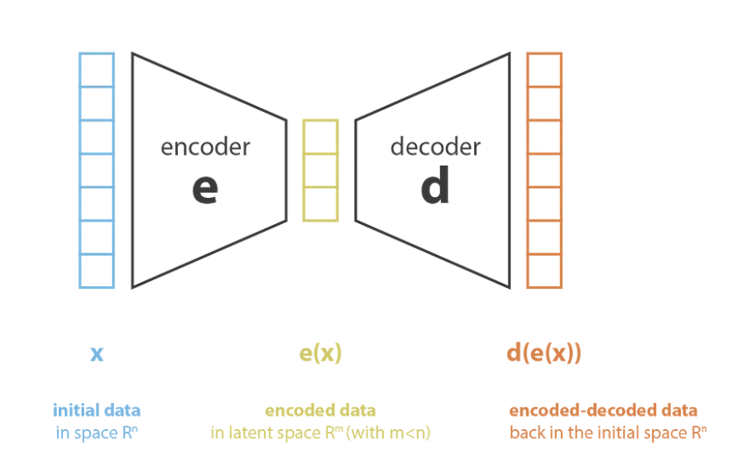
VAE: Autoencoder
How:
Learn lower-dimensional feature representation from unlabelled training data
Components:
Encoder: z = encoder(x)
Decoder: decoder(z) = decoder(encoder(x))
VAE
GAN
Diffusion Models
https://towardsdatascience.com/understanding-variational-autoencoders-vaes-f70510919f73

Slide 16
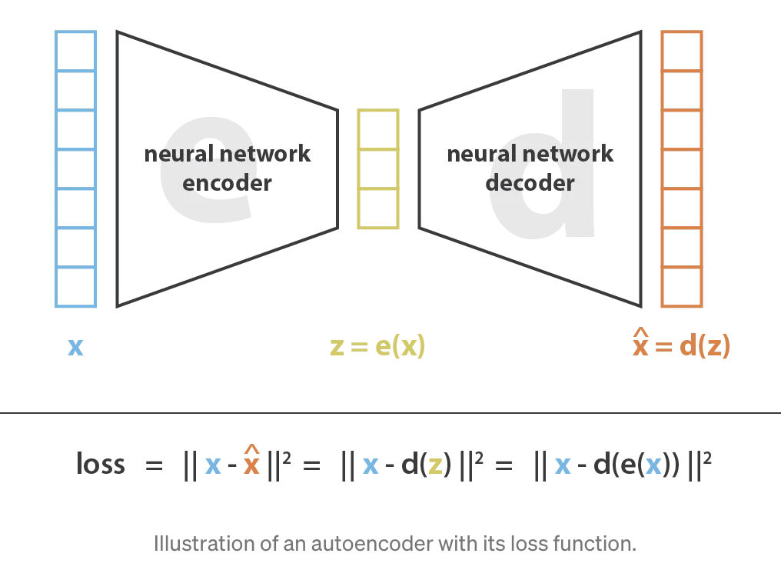
VAE: Autoencoder
VAE
GAN
Diffusion Models
Q: How to learn this new representation?
https://towardsdatascience.com/understanding-variational-autoencoders-vaes-f70510919f73

Slide 17
VAE: Autoencoder
VAE
GAN
Diffusion Models
Q: How can we use the low-dimensional embedding?
What part of the AE should we use?

Slide 18
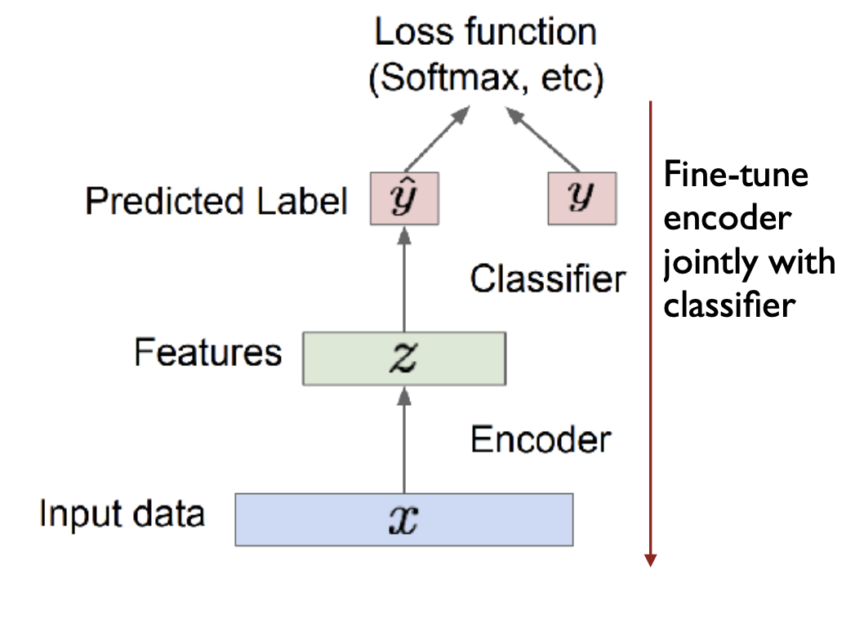
VAE: Autoencoder
VAE
GAN
Diffusion Models
Q: How can we use the low-dimensional embedding?
What part of the AE should we use?
Use the pretrained code z as a feature extractor
Input to a classifier with a smaller dataset

Slide 19
VAE: Autoencoder
VAE
GAN
Diffusion Models
Q: Can we use autoencoders to generate NEW samples?
What part should we use here?
Q: How can we interpolate between 2 inputs?
Q: Is overfitting a problem? How can we improve the model?

Slide 20
VAE: Autoencoder
VAE
GAN
Diffusion Models
Q: How can we use autoencoders to generate NEW samples?
What part should we use here?
z - random initialization
or
z - small variation
Q: How can we interpolate between 2 inputs?
In the hidden space.
Q: Is overfitting a problem? How can we improve the model?
Small size(z)
Focus on input variation and on weights (regularization)
DenoisingAE, SparseAE

Slide 21
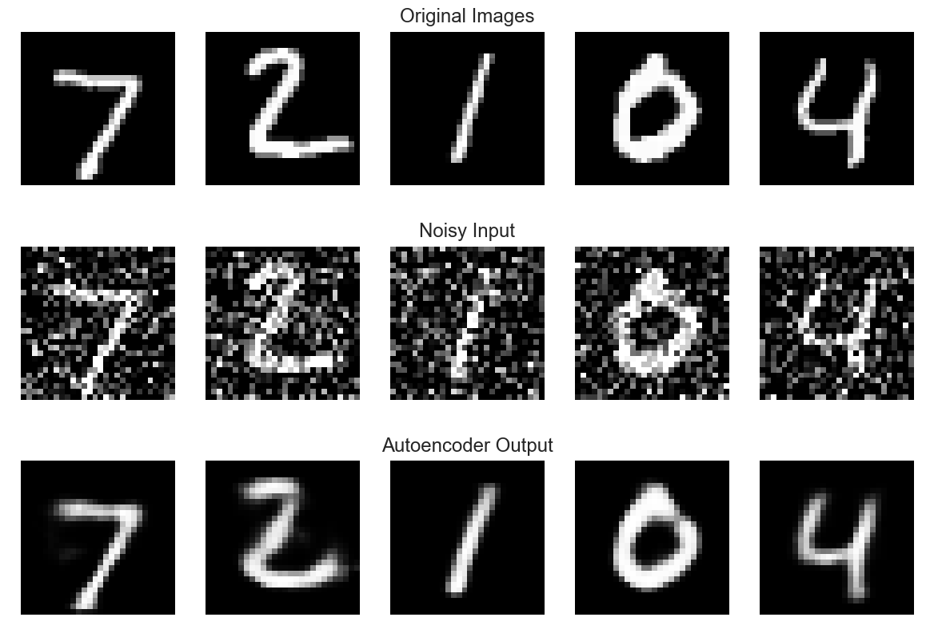
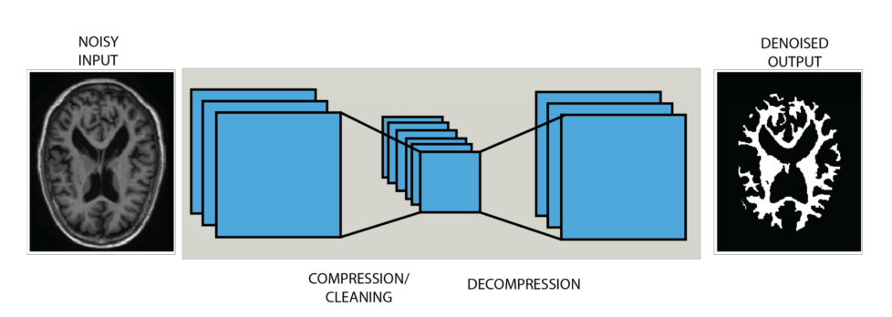
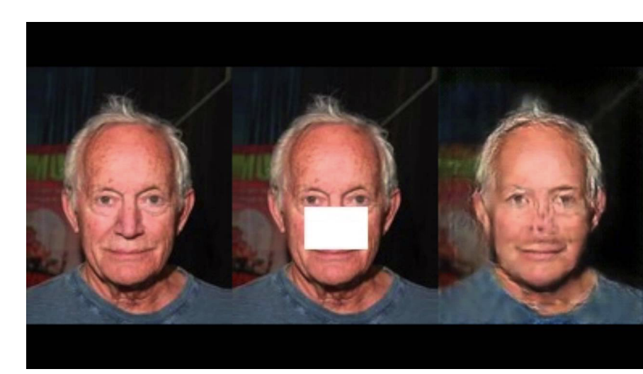
VAE: Autoencoder
VAE
GAN
Diffusion Models
Example use cases:
Denoising
Inpainting
SuperResolution
Anomaly detection
https://towardsdatascience.com/applied-deep-learning-part-3-autoencoders-1c083af4d798
https://faculty.cc.gatech.edu/~hays/7476/projects/Avery_Wenchen/

Slide 22
Variational AutoEncoder
VAE
GAN
Diffusion Models
Similar to AutoEncoder
Starts from the simple autoencoder architecture
Different from AutoEncoder
Explore variations on data you already have
Map the input into a distribution (instead of a fixed vector z)
mean and standard deviation for a multivariate Gaussian
z ~ sample from this distribution
the basic autoencoder generates z directly
Auto-Encoding Variational Bayes

Slide 23
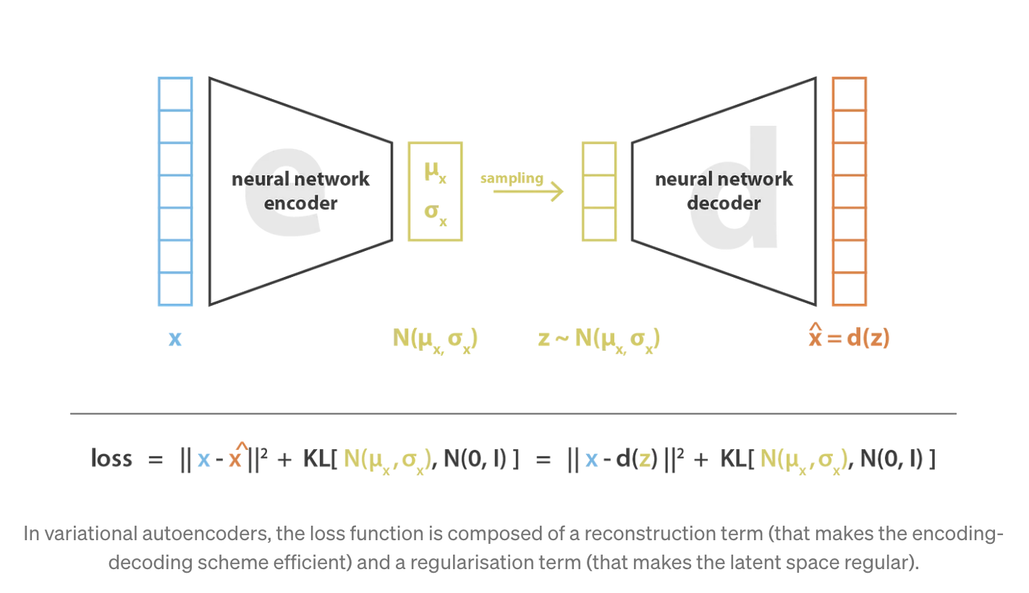
Variational AutoEncoder
VAE
GAN
Diffusion Models
https://towardsdatascience.com/understanding-variational-autoencoders-vaes-f70510919f73

Slide 24
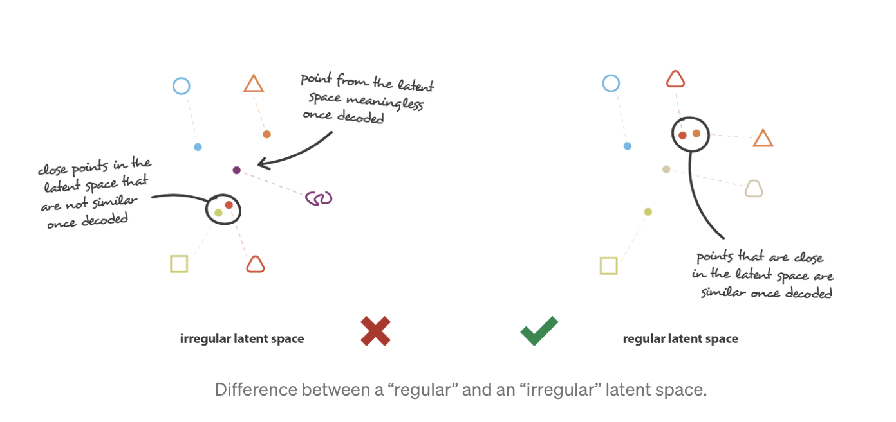
Variational AutoEncoder
VAE
GAN
Diffusion Models
Autoencoder Variational Autoencoder
https://towardsdatascience.com/understanding-variational-autoencoders-vaes-f70510919f73

Slide 25
Variational AutoEncoder
VAE
GAN
Diffusion Models
VAE is an autoencoder whose encodings distribution is regularised during the training
https://towardsdatascience.com/understanding-variational-autoencoders-vaes-f70510919f73

Slide 26
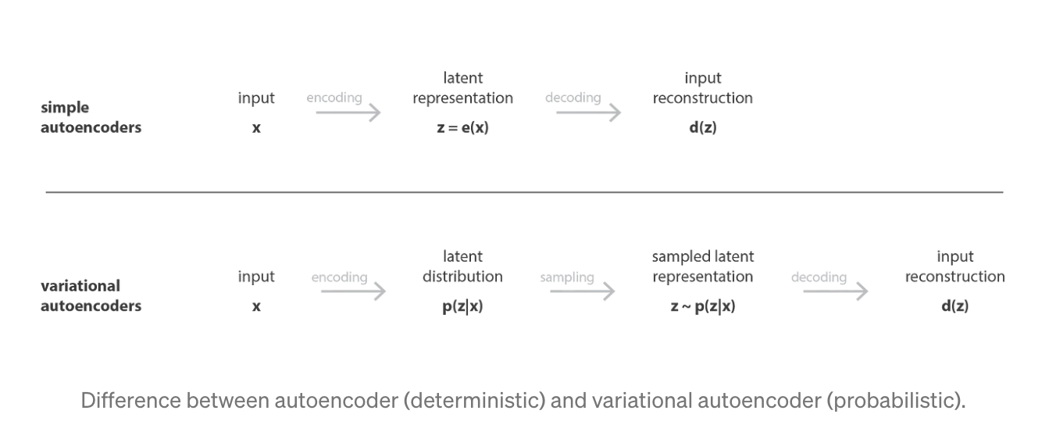
Variational AutoEncoder
VAE
GAN
Diffusion Models
https://towardsdatascience.com/understanding-variational-autoencoders-vaes-f70510919f73

Slide 27
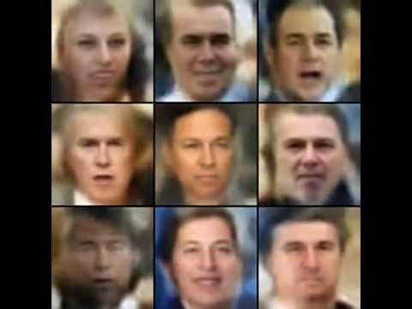
VAE - Faces in the Wild
VAE
GAN
Diffusion Models
https://www.youtube.com/watch?v=XNZIN7Jh3Sg

Slide 28
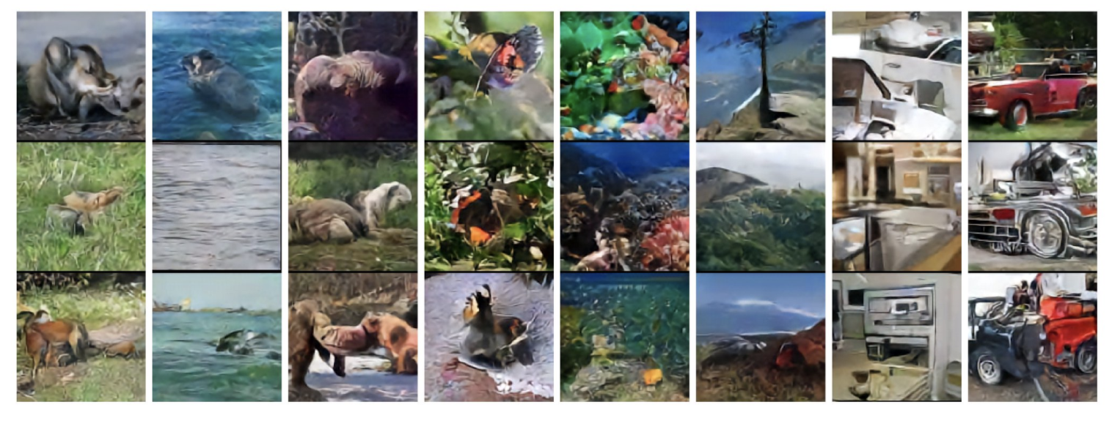
VQ-VAE - Images
VAE
GAN
Diffusion Models
https://arxiv.org/abs/1711.00937

Slide 29

VQ-VAE - Audio
VAE
GAN
Diffusion Models
Original Voice
Transfer to a new (given) voice
https://avdnoord.github.io/homepage/vqvae/

Slide 30
Generative Adversarial Networks
VAE
GAN
Diffusion Models
Two Networks, trained in an adversarial way:
Generator
Learns to generate plausible data
Discriminator
Learns to distinguish the real data from the generated ones
During training, they both become better step by step, by getting penalized when they are wrong
Generative Adversarial Nets

Slide 31
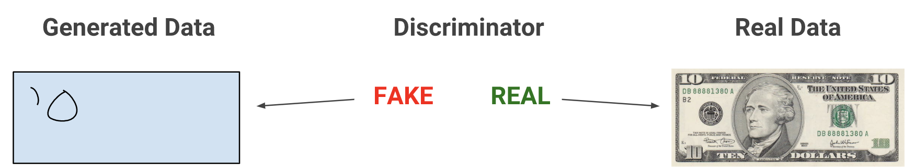
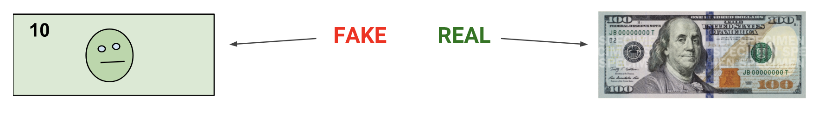
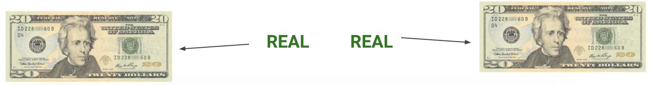
Generative Adversarial Networks
VAE
GAN
Diffusion Models
At the beginning, G is a very weak opponent
https://developers.google.com/machine-learning/gan

Slide 32
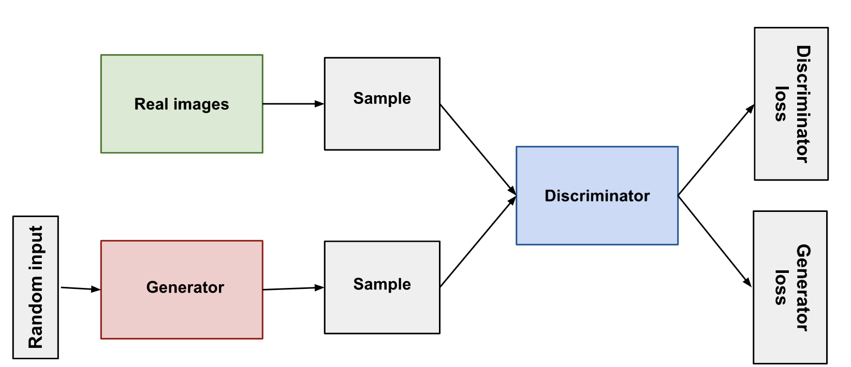
GAN - Architecture
VAE
GAN
Diffusion Models
Let the game begin and penalize both opponents when they are wrong.
https://developers.google.com/machine-learning/gan

Slide 33
GAN - Training
VAE
GAN
Diffusion Models
Problems
Train two different kinds of networks, with moving target
GAN convergence is hard to identify.
Loop until convergence (very unstable state):
Train only the discriminator for several epochs
Train the generator for several epochs (D is freezed here)
G never sees training data, only feedback from loss!
https://developers.google.com/machine-learning/gan

Slide 34
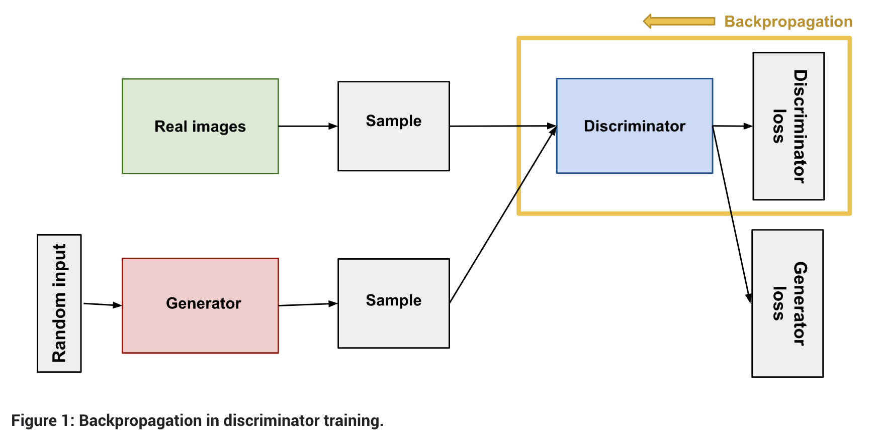
GAN - Discriminator
VAE
GAN
Diffusion Models
Real data: label 1 + Fake data from the generator: label 0
https://developers.google.com/machine-learning/gan

Slide 35
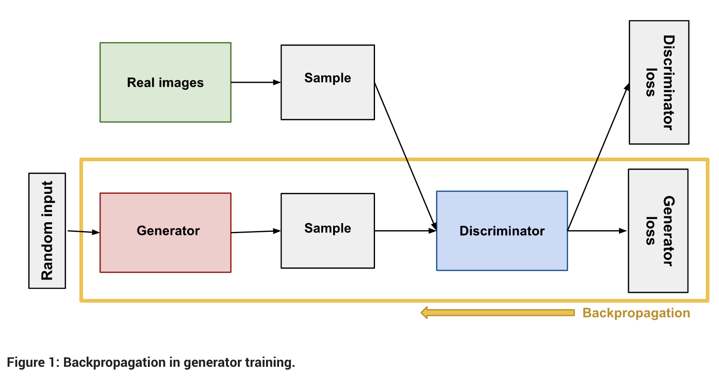
GAN - Generator
VAE
GAN
Diffusion Models
Train the Generator by keeping the Discriminator Freezed
https://developers.google.com/machine-learning/gan

Slide 36
GAN - Loss
VAE
GAN
Diffusion Models
Original MiniMax Loss:
G minimizes, D maximizes (loss values between (-inf, 0])
x - real sample, z - noise
D(x): probability given by D for the real sample x
G(z): generated sample, starting from noise z
G point of view (Q: Why minimizing?)
Ideally: D(G(z)) = 1 => 1 - D(G(z)) = 0 => log/loss is -inf
D point of view (Q: Why maximizing?)
Ideally: D(x) = 1, D(G(z)) = 0 => 1 - D(G(z)) = 1 => log/loss is 0
https://developers.google.com/machine-learning/gan

Slide 37
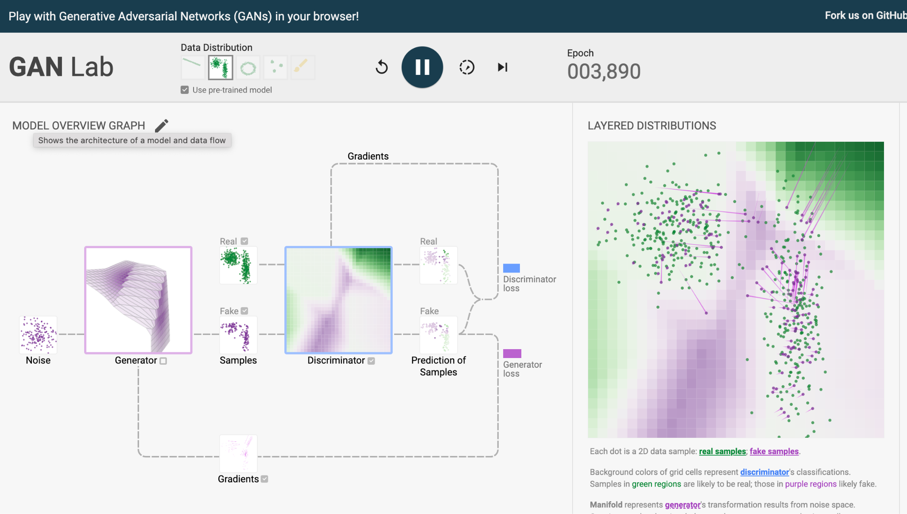
GAN - Training
VAE
GAN
Diffusion Models
https://poloclub.github.io/ganlab/

Slide 38
GAN - Common Problems
VAE
GAN
Diffusion Models
Vanishing Gradients
When the discriminator gets too good , generator training can fail due to vanishing gradient
An optimal discriminator doesn't provide enough information for the generator to make progress.
Mode Collapse
Ideally, we want GAN to produce a wide variety of outputs.
If a generator produces an especially plausible output, the generator may learn to produce only that output.
https://developers.google.com/machine-learning/gan

Slide 39
GAN - Wasserstein Loss
VAE
GAN
Diffusion Models
Huge improvements in terms of stability
Comes with theoretical proofs and guarantees
D gives a score, instead for a probability
should be large for real data: D(x)
should be low for fake data: D(G(z))
Simpler Loss:
G maximizes: D(G(z))
wants the discriminator to be wrong, to say it is real data
D maximizes: D(x) - D(G(z))
wants to give higher scores for real and low for fake
https://developers.google.com/machine-learning/gan

Slide 40
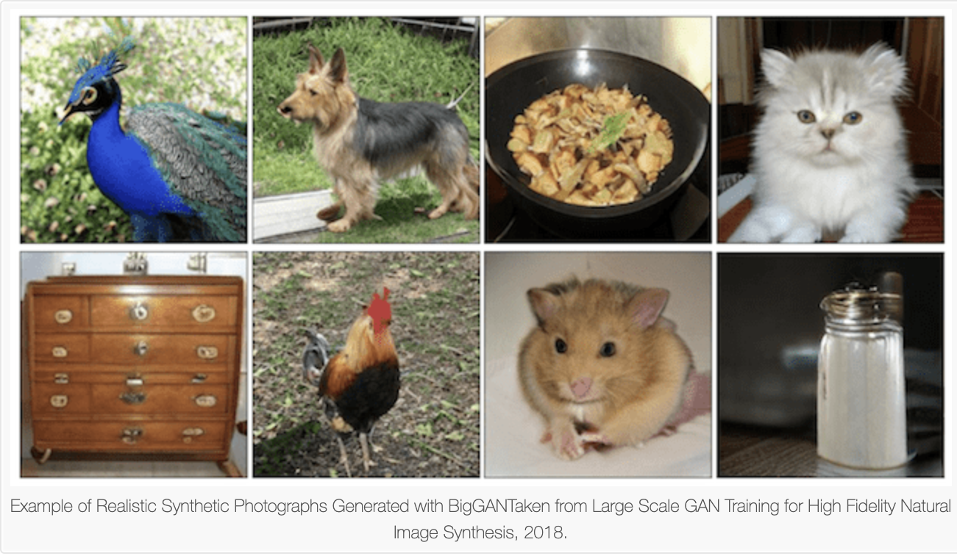
GAN - Use Cases
VAE
GAN
Diffusion Models
https://machinelearningmastery.com/impressive-applications-of-generative-adversarial-networks/

Slide 41
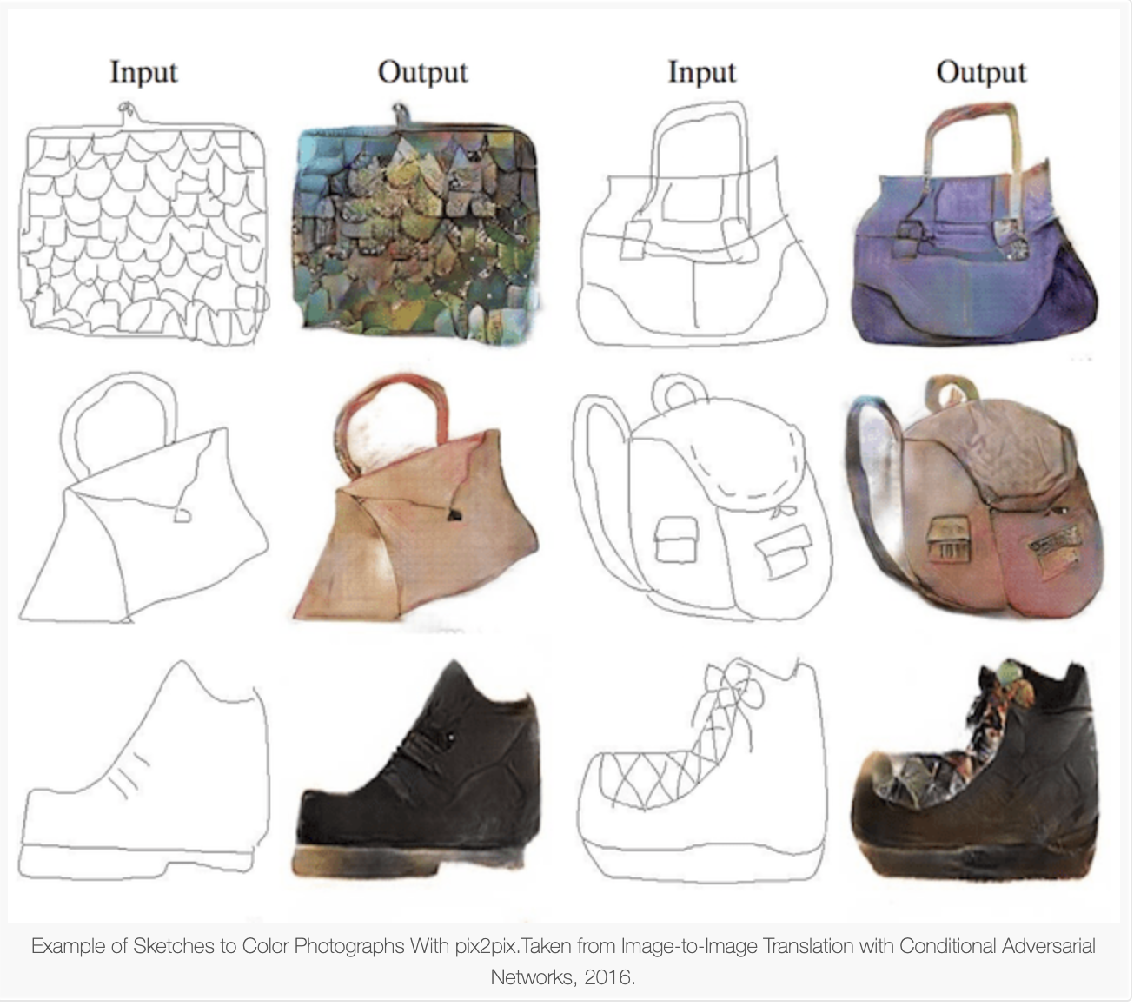
GAN - Use Cases
VAE
GAN
Diffusion Models
https://machinelearningmastery.com/impressive-applications-of-generative-adversarial-networks/

Slide 42
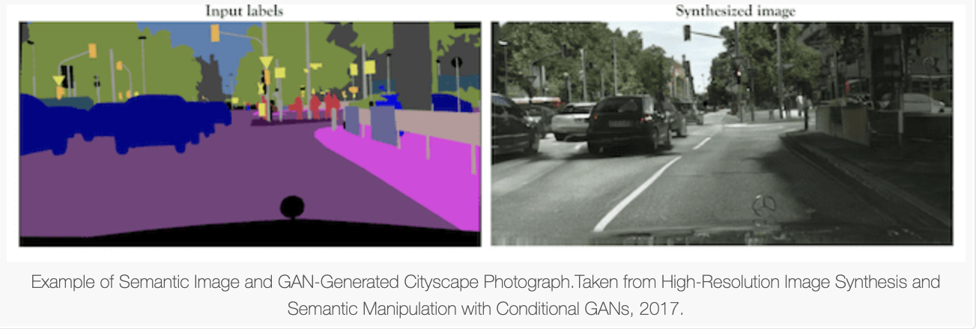
GAN - Use Cases
VAE
GAN
Diffusion Models
https://machinelearningmastery.com/impressive-applications-of-generative-adversarial-networks/

Slide 43
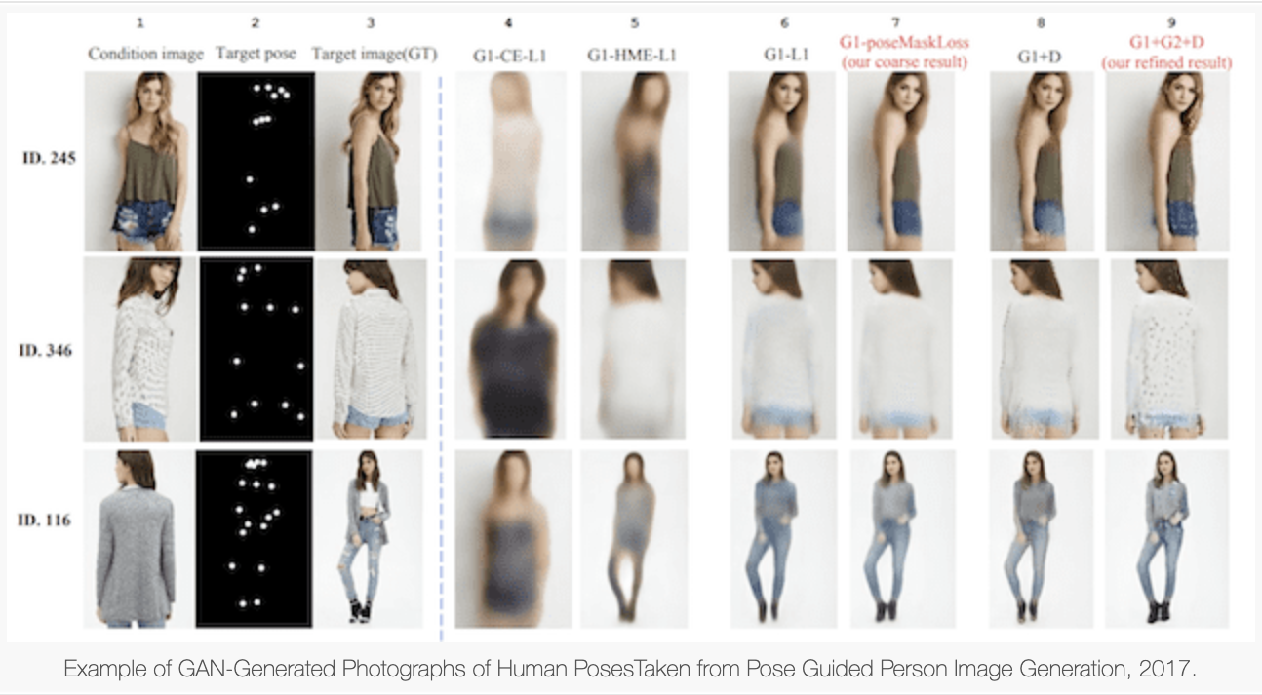
GAN - Use Cases
VAE
GAN
Diffusion Models
https://machinelearningmastery.com/impressive-applications-of-generative-adversarial-networks/

Slide 44
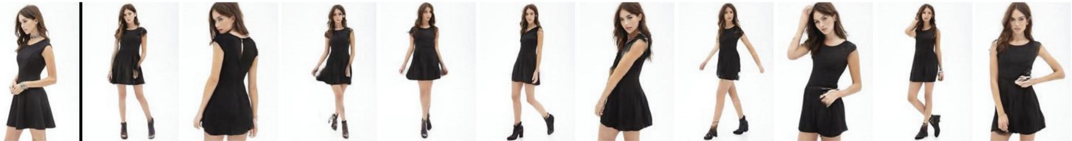
GAN - Use Cases
VAE
GAN
Diffusion Models
Generating different poses of a person.
Human Synthesis and Scene Compositing

Slide 45
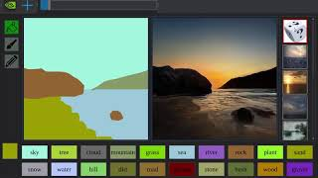

Slide 46
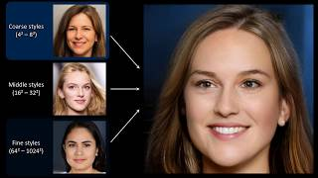

Slide 47
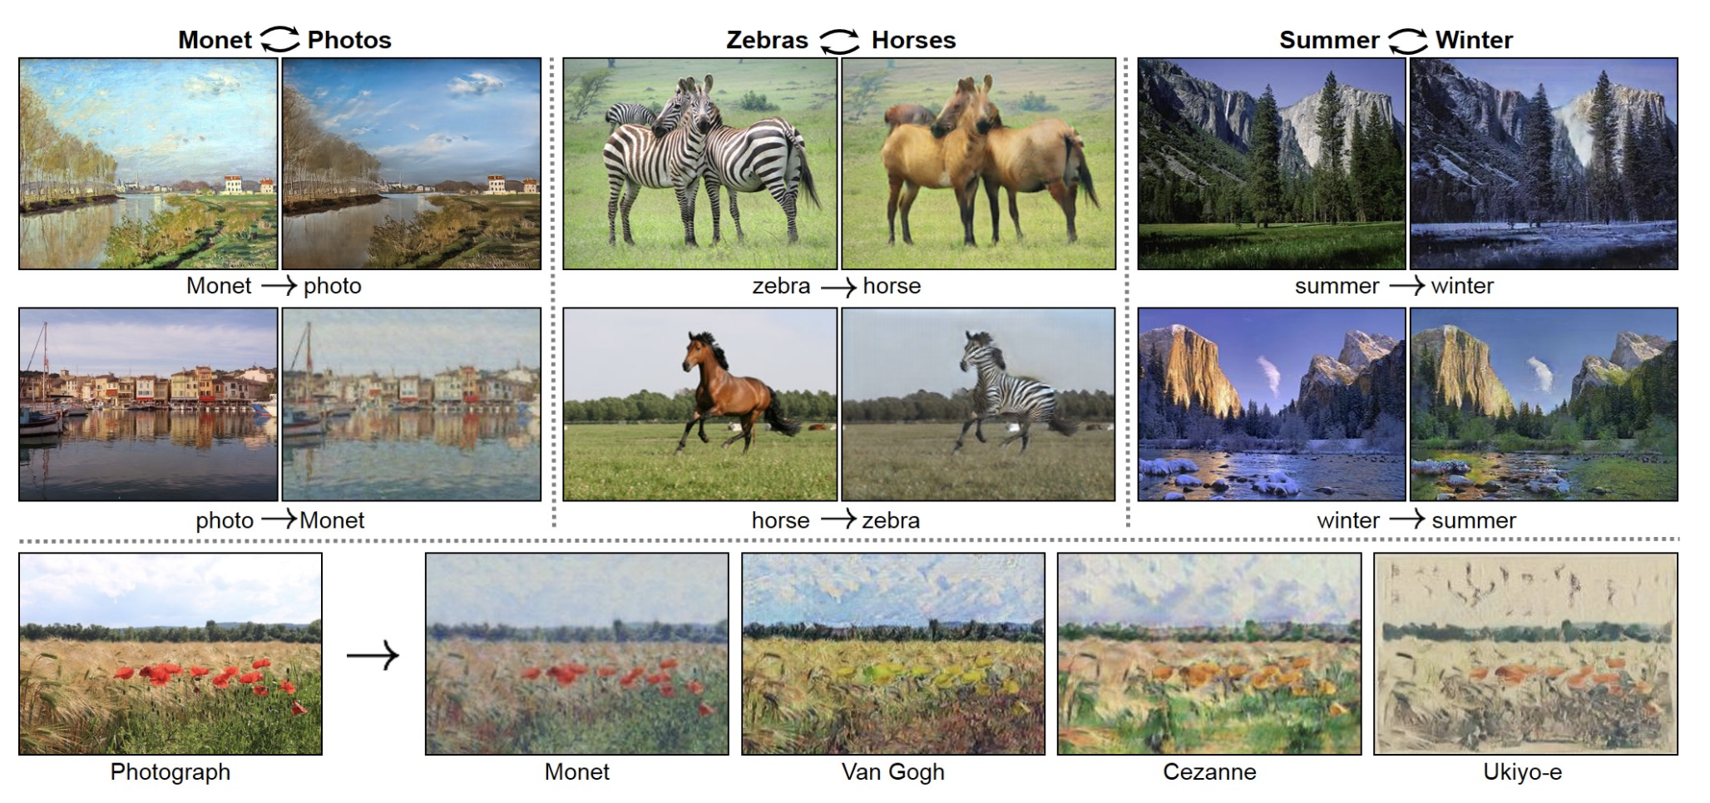
CycleGAN
VAE
GAN
Diffusion Models
https://junyanz.github.io/CycleGAN/

Slide 48
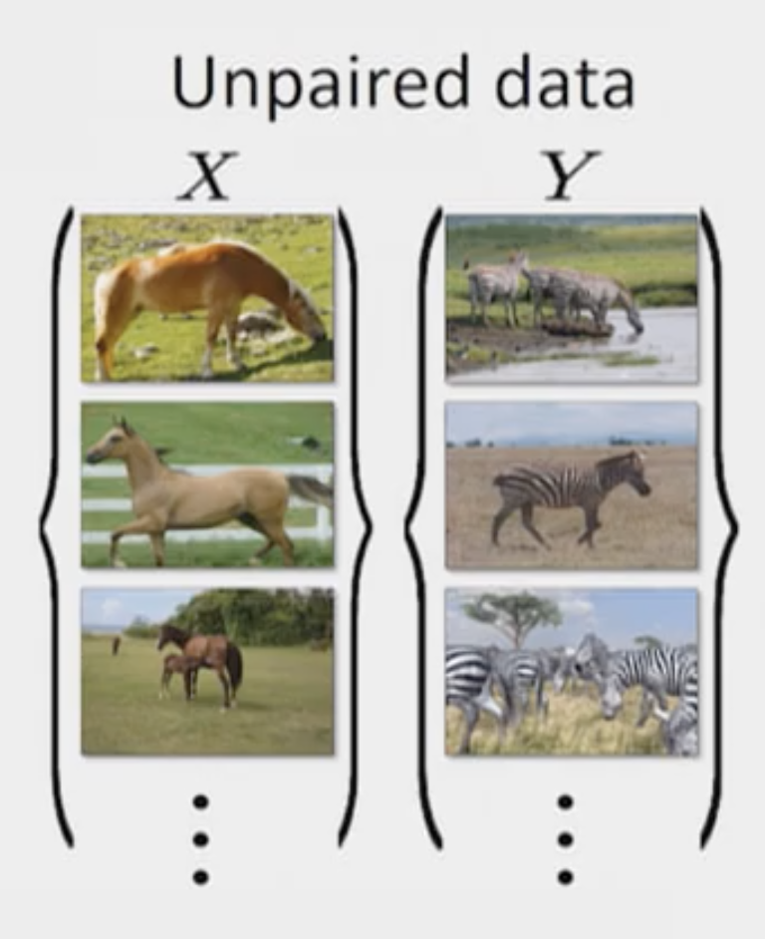
CycleGAN
VAE
GAN
Diffusion Models
Unpaired Image-to-Image Translation
using
Cycle-Consistent Adversarial Networks

Slide 49
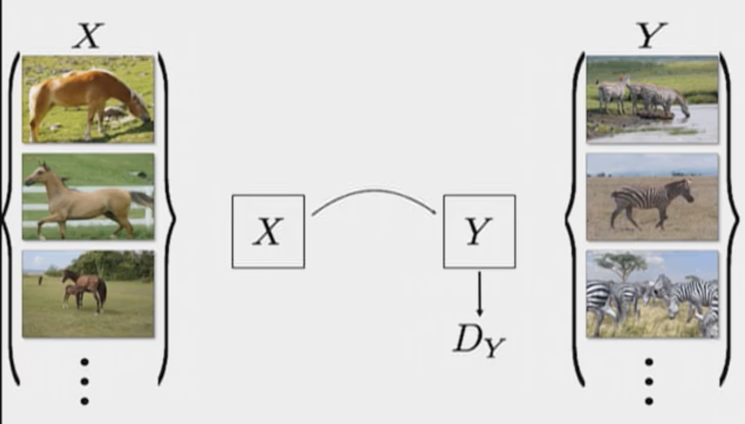
CycleGAN - Intuition
VAE
GAN
Diffusion Models
Q: What will the Generator learn?

Slide 50
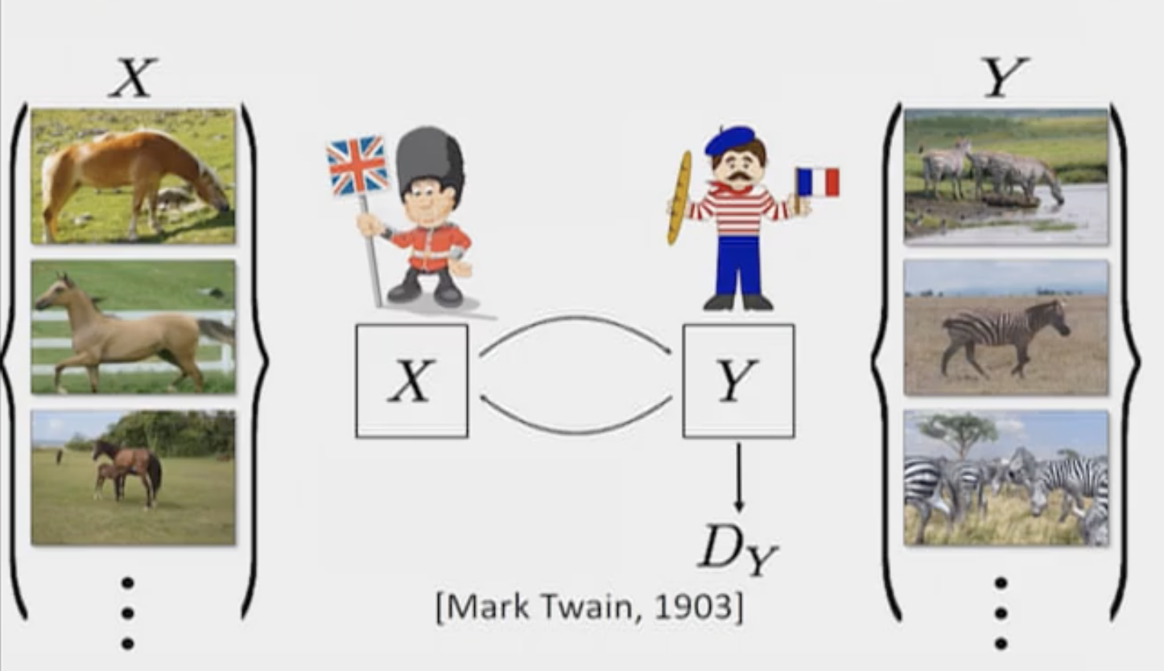
CycleGAN - Intuition
VAE
GAN
Diffusion Models
Cycle Consistency Constraint

Slide 51
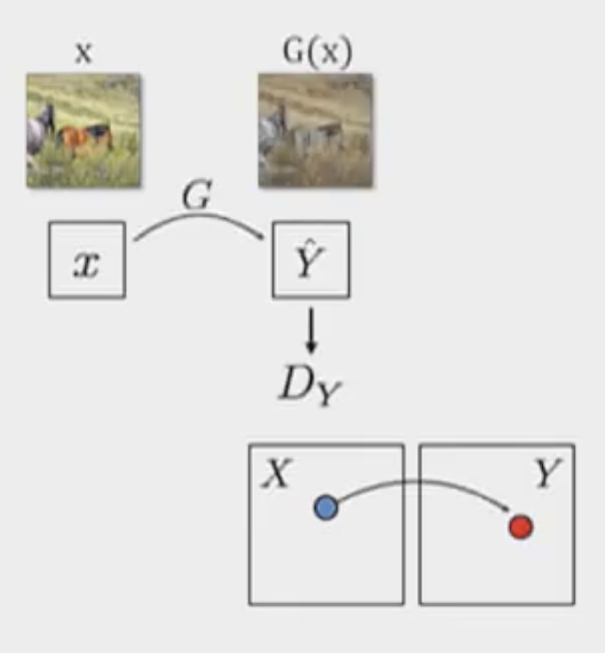
CycleGAN - Architecture
VAE
GAN
Diffusion Models
Go to Y space:
G: X -> Y
D: Y -> [0, 1]

Slide 52
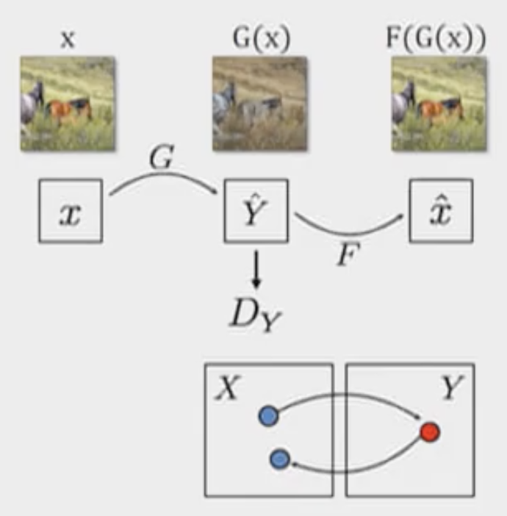
CycleGAN - Architecture
VAE
GAN
Diffusion Models
Go to Y space:
G: X -> Y
D: Y -> [0, 1]
Go back to X space:
F : Y -> X

Slide 53
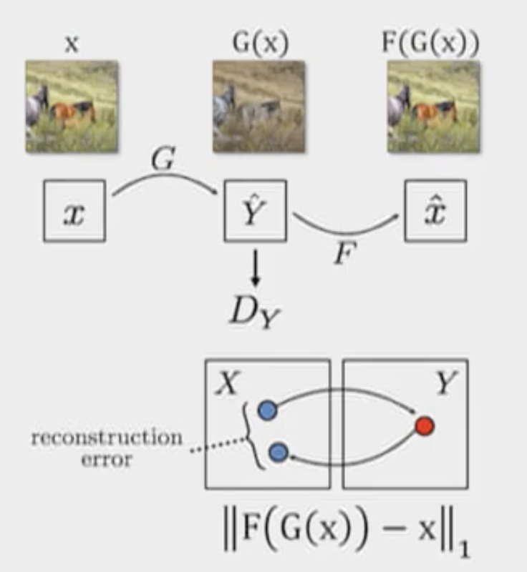
CycleGAN - Architecture
VAE
GAN
Diffusion Models
Go to Y space:
G: X -> Y
D: Y -> [0, 1]
Go back to X space:
F : Y -> X
Goal: new X is close to initial X

Slide 54
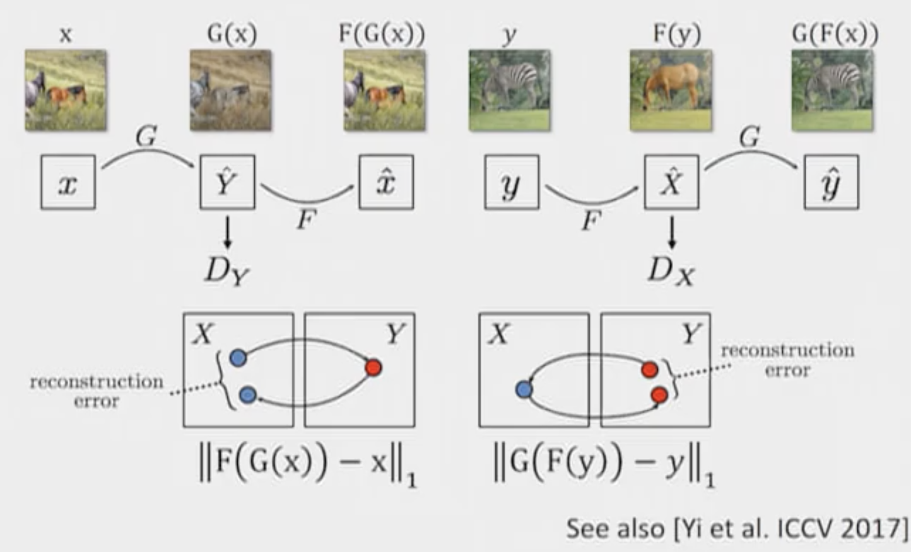
CycleGAN - Architecture
VAE
GAN
Diffusion Models

Slide 55
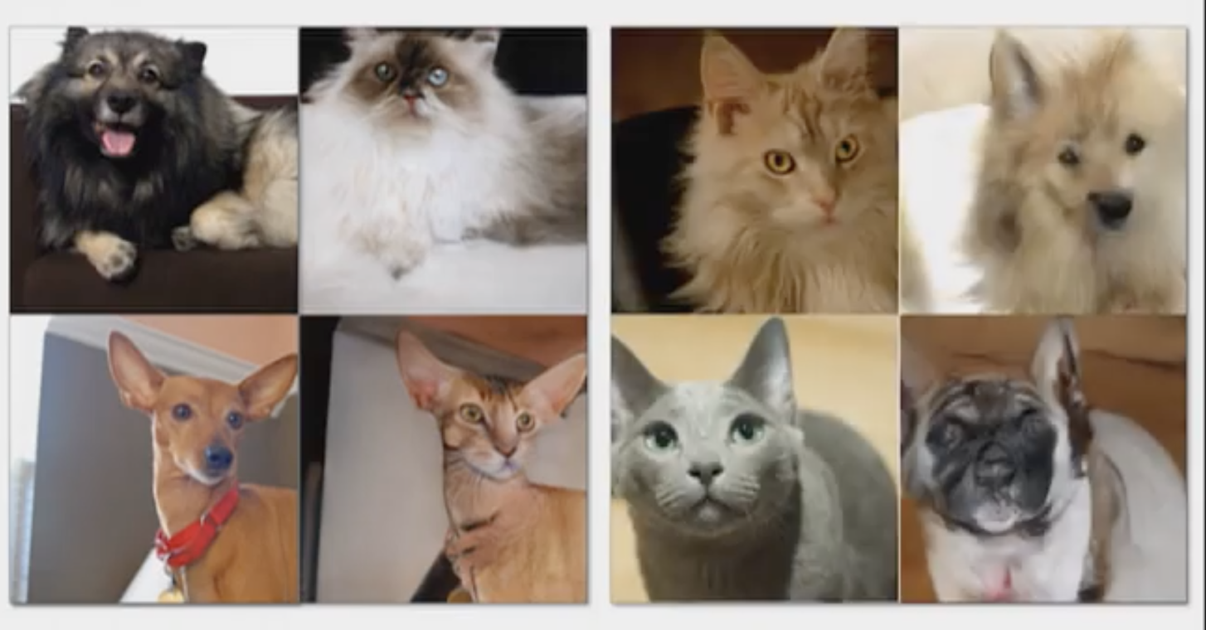
CycleGAN
VAE
GAN
Diffusion Models

Slide 56
CycleGAN
VAE
GAN
Diffusion Models
Monet ↔ Thomas Kinkade
Animal Transfiguration
Portrait to Dollface
Face ↔ Ramen :| google it
Colorizing legacy photographs
Cats ↔ Dogs
The Electronic Curator

Slide 57
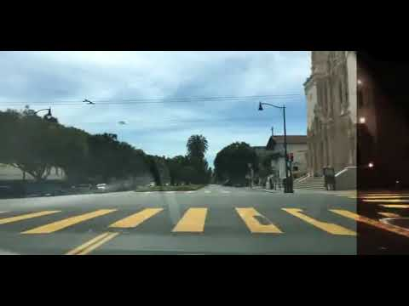
CycleGAN - Day to Night
VAE
GAN
Diffusion Models
https://junyanz.github.io/CycleGAN/

Slide 58
Diffusion Models
VAE
GAN
Diffusion Models
Diffusion Models: Theory
Diffusion Models Overview
Forward Diffusion Process
Reverse Denoising Process
Training Diffusion Models: Simple Loss
Comparison to GANs
Latent Diffusion Models
Diffusion Models: Applications
Stable Diffusion
Imagen
Dalle-2
Repaint

Slide 59
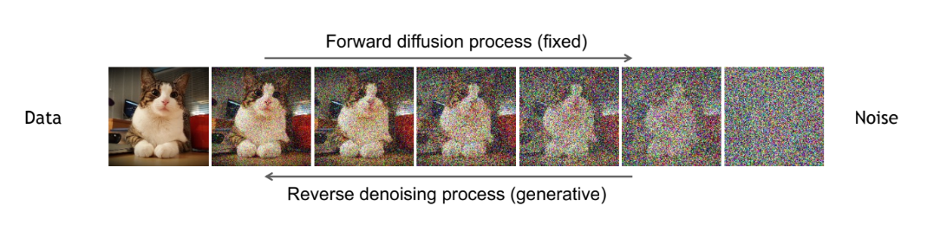
Diffusion Models Overview
VAE
GAN
Diffusion Models
Denoising Diffusion Models consist of two processes:
• Forward diffusion process that gradually adds noise to input
• Reverse denoising process that learns to generate data by denoising
CVPR 2022 Tutorial: Denoising Diffusion-based Generative Modeling:Foundations and Applications

Slide 60
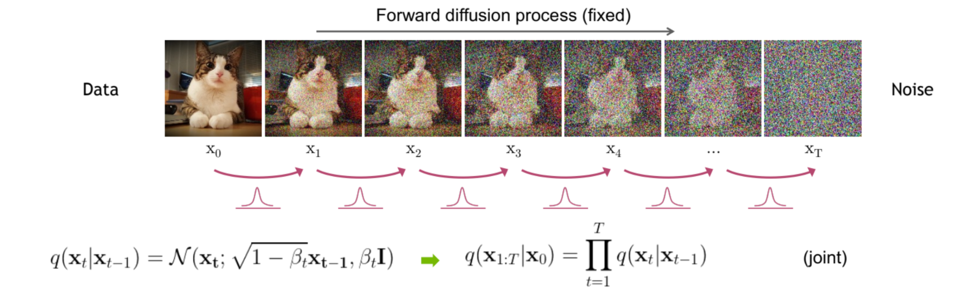
Forward Diffusion Process
The original image ( ) is slowly corrupted iteratively by adding Gaussian noise.
This process is done for some T time steps,
Image at timestep t is created by:
No model is involved at this stage.
At the end, is pure noise.
VAE
GAN
Diffusion Models
CVPR 2022 Tutorial: Denoising Diffusion-based Generative Modeling:Foundations and Applications
https://learnopencv.com/image-generation-using-diffusion-models/

Slide 61
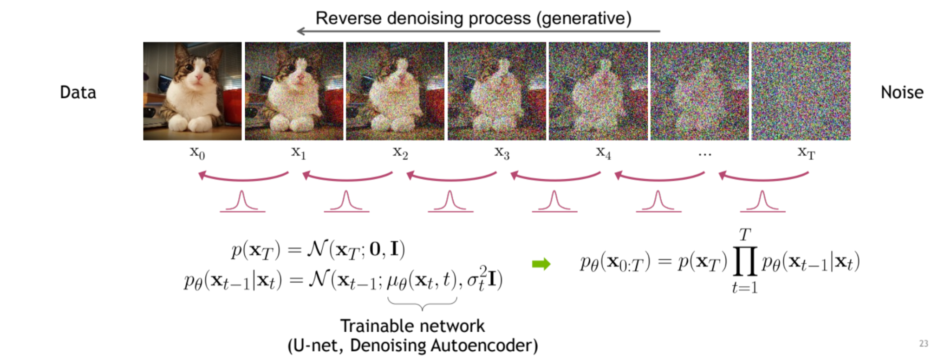
Reverse Denoising Process
VAE
GAN
Diffusion Models
We undo the forward process by removing the noise added in the forward process using a neural network model.
Given a timestep t and the noisy image predict the noise added to the image at step t-1.
CVPR 2022 Tutorial: Denoising Diffusion-based Generative Modeling:Foundations and Applications

Slide 62
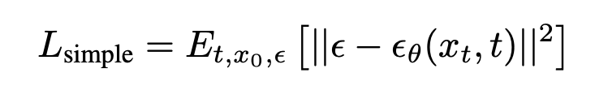
Training Diffusion Models: Simple Loss
VAE
GAN
Diffusion Models
In practice, the final loss function we use to train Denoising Diffusion Probabilistic Models, is just a Mean Squared Error between the noise added in the forward process and the noise predicted by the model.
CVPR 2022 Tutorial: Denoising Diffusion-based Generative Modeling:Foundations and Applications
Denoising Diffusion Probabilistic Models

Slide 63
Comparison to VAEs
VAE
GAN
Diffusion Models
Both have an inference model (forward process), transforming data to latent representation. For Diffusion Models this process is fixed.
Both have a generative model ( reverse process) that samples some latent variable and transforms it with a neural network. In Diffusion Models this is done iteratively.
In Diffusion Models latent dimensionality must match the data. In VAEs we can reduce dimensionality.
https://angusturner.github.io/generative_models/2021/06/29/diffusion-probabilistic-models-I.html

Slide 64
Comparison to GANs
VAE
GAN
Diffusion Models
Due to the iterative nature of the diffusion process, the training and generation process is generally more stable than GANs.
In Diffusion Models latent dimensionality must match the data. In GANs, the latent tensor can be of different sizes.
Diffusion models only require one model.
https://learnopencv.com/image-generation-using-diffusion-models/

Slide 65
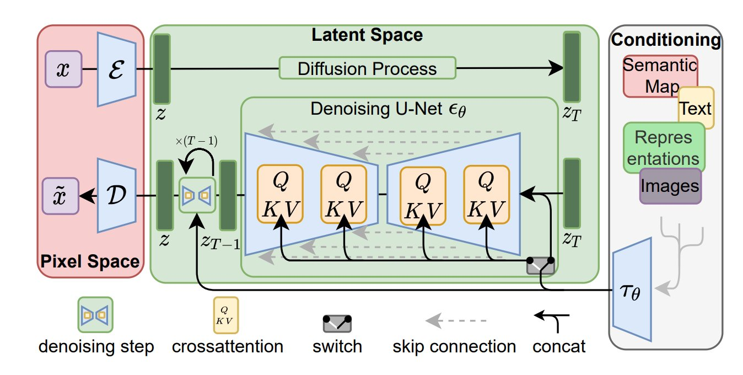
Latent Diffusion Models
VAE
GAN
Diffusion Models
High-Resolution Image Synthesis with Latent Diffusion Models

Slide 66
Diffusion Models
VAE
GAN
Diffusion Models
Diffusion Models: Theory
Diffusion Models Overview
Forward Diffusion Process
Reverse Denoising Process
Training Diffusion Models: Simple Loss
Comparison to GANs
Latent Diffusion Models
Diffusion Models: Examples
Stable Diffusion
Imagen
Dalle-2
Repaint

Slide 67
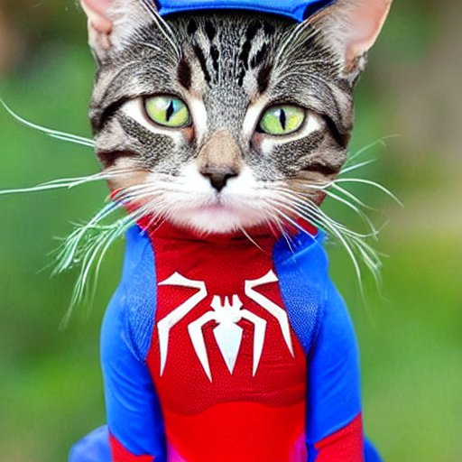
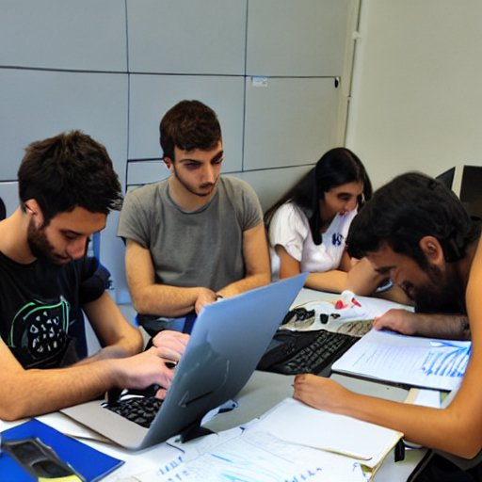
Diffusion Models: Stable Diffusion
VAE
GAN
Diffusion Models
A cat wearing a spiderman suit.
Students during deep learning course at the University of Bucharest
https://stablediffusionweb.com/

Slide 68
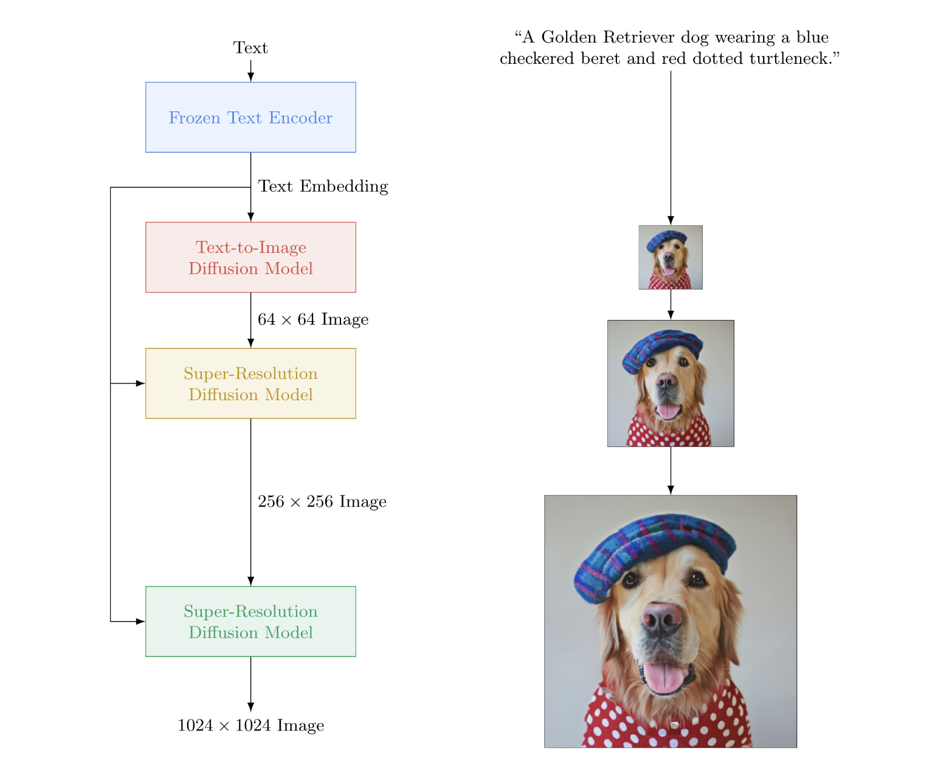
Diffusion Models: Imagen
VAE
GAN
Diffusion Models
Photorealistic Text-to-Image Diffusion Models with Deep Language Understanding

Slide 69
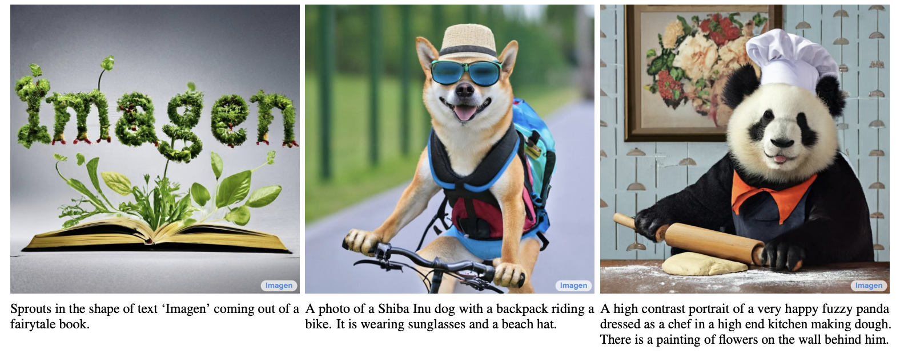
Diffusion Models: Imagen
VAE
GAN
Diffusion Models
Photorealistic Text-to-Image Diffusion Models with Deep Language Understanding

Slide 70


Diffusion Models: Imagen
VAE
GAN
Diffusion Models
A teddy bear washing the dishes.
Wooden figurine surfing on a snowboard in space.
Photorealistic Text-to-Image Diffusion Models with Deep Language Understanding

Slide 71

Diffusion Models: Dalle-2
VAE
GAN
Diffusion Models
Hierarchical Text-Conditional Image Generation with CLIP Latents
https://openai.com/product/dall-e-2

Slide 72

Diffusion Models: Dalle-2
VAE
GAN
Diffusion Models
Hierarchical Text-Conditional Image Generation with CLIP Latents
https://openai.com/product/dall-e-2

Slide 73


Diffusion Models: Repaint
VAE
GAN
Diffusion Models
Inpainting using Denoising Diffusion Probabilistic Models,

Slide 74

Diffusion Models: Repaint
VAE
GAN
Diffusion Models
Inpainting using Denoising Diffusion Probabilistic Models

Slide 75

Diffusion Models: Repaint
VAE
GAN
Diffusion Models
Inpainting using Denoising Diffusion Probabilistic Models,

Slide 76

Diffusion Models: Repaint
VAE
GAN
Diffusion Models
Inpainting using Denoising Diffusion Probabilistic Models,

Slide 77
Thank you!
Next: Project presentations.

Slide 78
References
https://sites.google.com/view/berkeley-cs294-158-sp19/home
https://towardsdatascience.com/generating-images-with-autoencoders-77fd3a8dd368
https://m2dsupsdlclass.github.io/lectures-labs/slides/10_unsupervised_generative_models
https://lilianweng.github.io/lil-log/2018/08/12/from-autoencoder-to-beta-vae.html
https://courses.cs.ut.ee/LTAT.02.001/2017_fall/uploads/Main/Lecture%2011%20-%20NN%202017-18.pdf
http://www.cs.cmu.edu/~bhiksha/courses/deeplearning/Spring.2018/www/slides/lec16.vae.pdf
https://developers.google.com/machine-learning/gan
https://storage.googleapis.com/deepmind-media/UCLxDeepMind_2020/L10%20-%20UCLxDeepMind%20DL2020.pdf

Slide 79
References
Auto-Encoding Variational Bayes, Diederik P. Kingma , Max Welling (2013)
Generative Adversarial Nets, Ian J. Goodfellow, Jean Pouget-Abadie,, Mehdi Mirza, Bing Xu, David Warde-Farley, Sherjil Ozair , Aaron Courville, Yoshua Bengio (2014)
RePaint: Inpainting using Denoising Diffusion Probabilistic Models, Andreas Lugmayr Martin Danelljan Andres Romero Fisher Yu Radu Timofte Luc Van Gool (2022)
Deep Unsupervised Learning using Nonequilibrium Thermodynamics Jascha Sohl-Dickstein, Eric A. Weiss, Niru Maheswaranathan, Stanford University, Surya Ganguli (2015)
Denoising Diffusion Probabilistic Models, Jonathan Ho, Ajay Jain, Pieter Abbeel (2015)
High-Resolution Image Synthesis with Latent Diffusion Models, Robin Rombach, Andreas Blattmann, Dominik Lorenz, Patrick Esser, Bjorn Ommer (2022)

